Slide 1

MAJOR PROJECT
ON
CROP RECOMMENDATION SYSTEM
Submitted to
AMITY UNIVERSITY, KOLKATA
for the partial fulfillment of the award of the degree
MASTER OF COMPUTER APPLICATIONS
by
ARYADEV MONDAL
A914145023006
Under the guidance of
Dr. Dipanwita Sadhukhan
AMITY INSTITUTE OF INFORMATION TECHNOLOGY, KOLKATA
AMITY UNIVERSITY, KOLKATA
May 2025

Slide 2

Soil Analysis (Agricultural Assistant)
This presentation introduces a web-based agricultural assistant designed for soil analysis and crop management. Leveraging machine learning and deep learning techniques, the assistant aims to optimize crop yields and promote sustainable farming practices. The following slides will cover the problem statement, proposed solution, system architecture, key technologies, data and models, web interface, results, and future work.

Slide 3
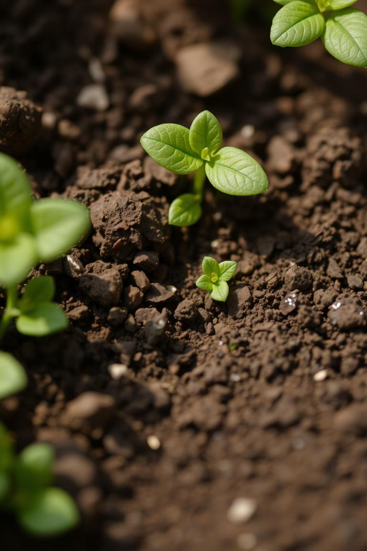


Introduction & Problem Statement
Soil analysis is crucial for achieving the best crop yields and promoting sustainable farming. However, the current soil testing methods can be slow and expensive, resulting in delayed results that affect important decisions. Additionally, disease detection methods that rely on personal judgment and one-size-fits-all fertilizer suggestions add to these challenges.
Time and Cost
Traditional soil testing can be prohibitively expensive and slow.
Lack of Integration
Existing tools often lack seamless integration.

Slide 4
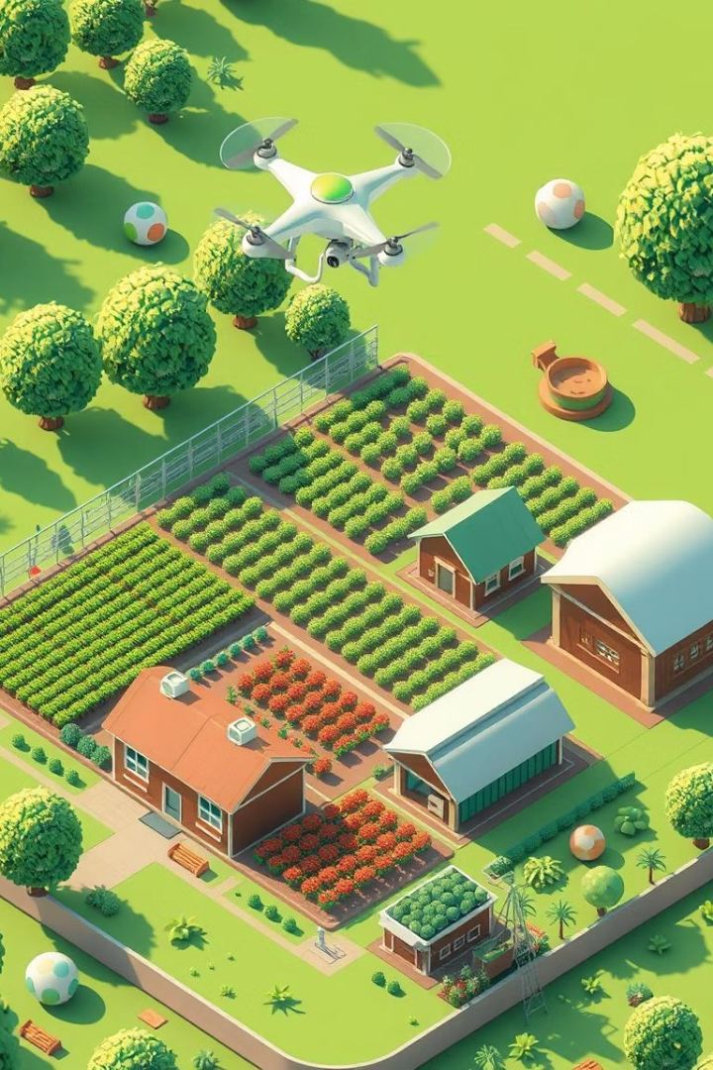
Proposed Solution
To address the challenges of current soil analysis practices, we propose a comprehensive web-based system. The system offers four key services designed to provide data-driven insights for farmers. These services include crop recommendation, fertilizer recommendation, crop disease prediction, and soil type analysis. This integrated platform aims to empower farmers to make informed decisions, optimizing their crop yields and promoting sustainability.
Crop Recommendation
ML-based suggestions for optimal crop selection.

Slide 5

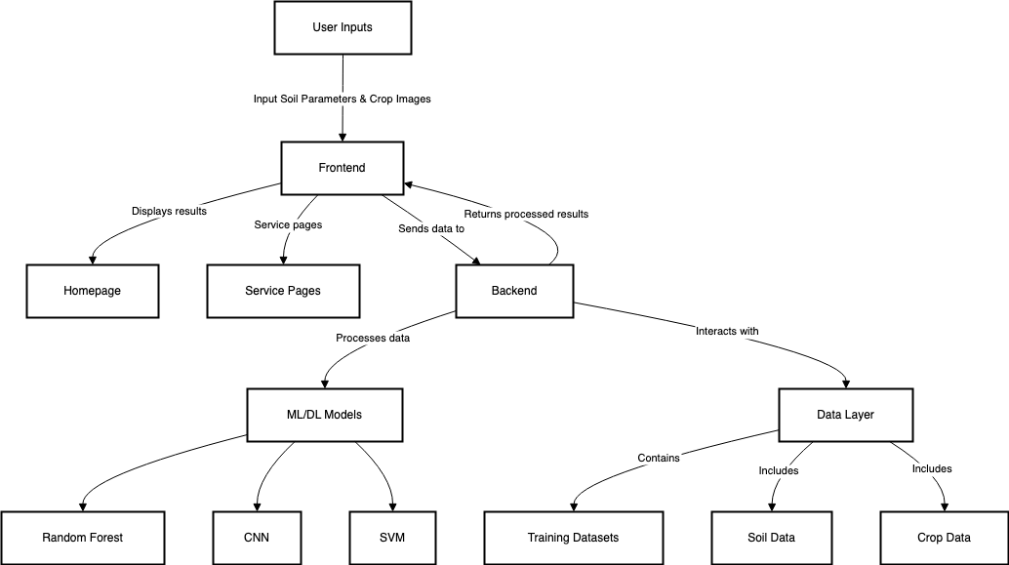


System Architecture
The system architecture comprises three essential layers: the frontend, backend, and data layer. The frontend is developed using HTML, CSS, and JavaScript to ensure a user-friendly and interactive experience. The backend, built with Flask, handles the processing and integration of machine learning models. The data layer houses the datasets used for training the models and processes real-time inputs from users.
Frontend
HTML/CSS/JavaScript for user interaction.
Backend
Flask for processing and model integration.
Data Layer
Datasets for training and real-time inputs.

Slide 6




Key Technologies
The agricultural assistant leverages a range of cutting-edge technologies to deliver accurate and efficient results. Machine learning algorithms, including Random Forest and Support Vector Machines (SVM), are employed for crop and fertilizer recommendations, as well as soil type analysis. Deep learning techniques, specifically Convolutional Neural Networks (CNN), are used for image-based crop disease prediction.
Machine Learning
Deep Learning
Python

Slide 7
Data and Models
The system's performance is heavily reliant on the quality and quantity of data used to train the models. The datasets include soil data comprising 10,000 samples with various parameters such as pH, nitrogen (N), phosphorus (P), and potassium (K) levels. Additionally, a dataset of 50,000 crop images sourced from PlantVillage is used for training the CNN model for disease prediction.
Soil Data
Crop Images
10,000 samples with pH, N, P, K, etc.
50,000 from PlantVillage.
Random Forest
Support Vector Machine (SVM)
Convolutional Neural Network (CNN)
Used for Crop Recommendation and Fertilizer Recommendation, trained on soil data to predict suitable crops and fertilizer types with high accuracy (92% and 90%, respectively).
Applied for Soil Type Analysis, classifying soil types based on chemical and physical properties, achieving 87% accuracy.
Employed for Crop Disease Prediction, analyzing crop images to detect diseases with 89% accuracy, using a model with convolutional, pooling, and dense layers.

Slide 8

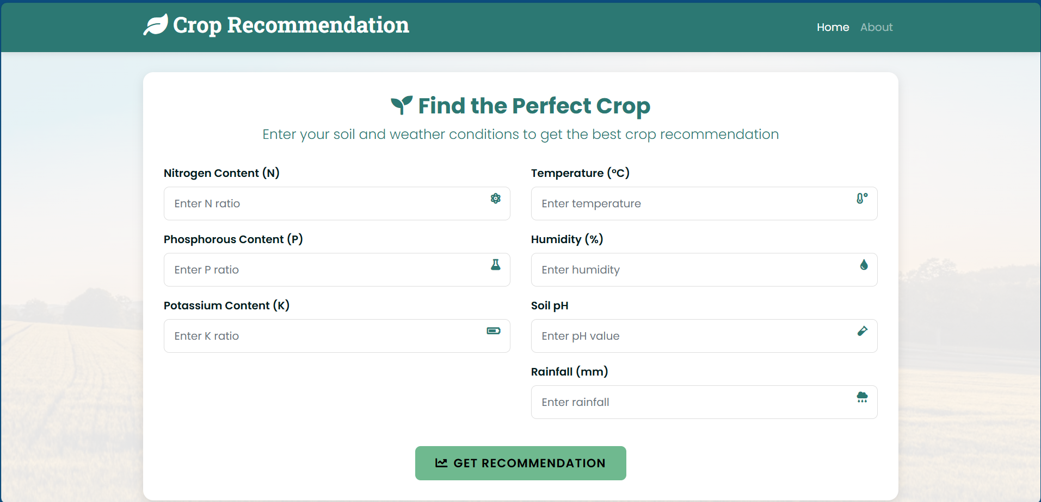
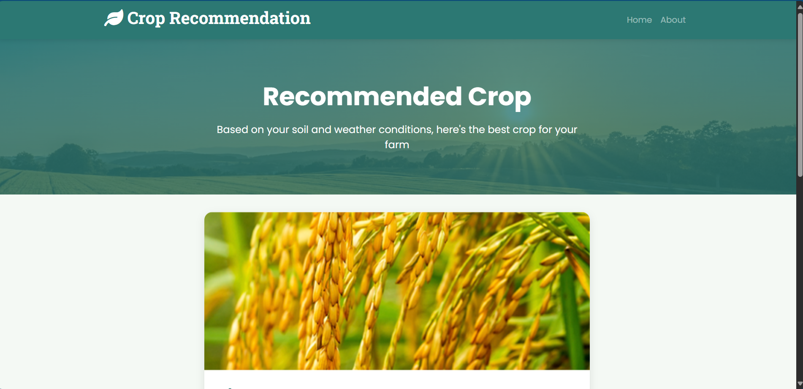
Web Interface
The web interface is designed to be intuitive and accessible, ensuring that farmers can easily interact with the system. It features user-friendly forms for inputting soil parameters and uploading crop images. Results are displayed clearly using tables and charts, making it easy to interpret the data. The interface is also responsive, ensuring accessibility across various devices.
Intuitive Forms
Easy input of soil parameters and images.
Clear Display
Results presented in tables and charts.
Responsive Design
Accessible across various devices.

Slide 9
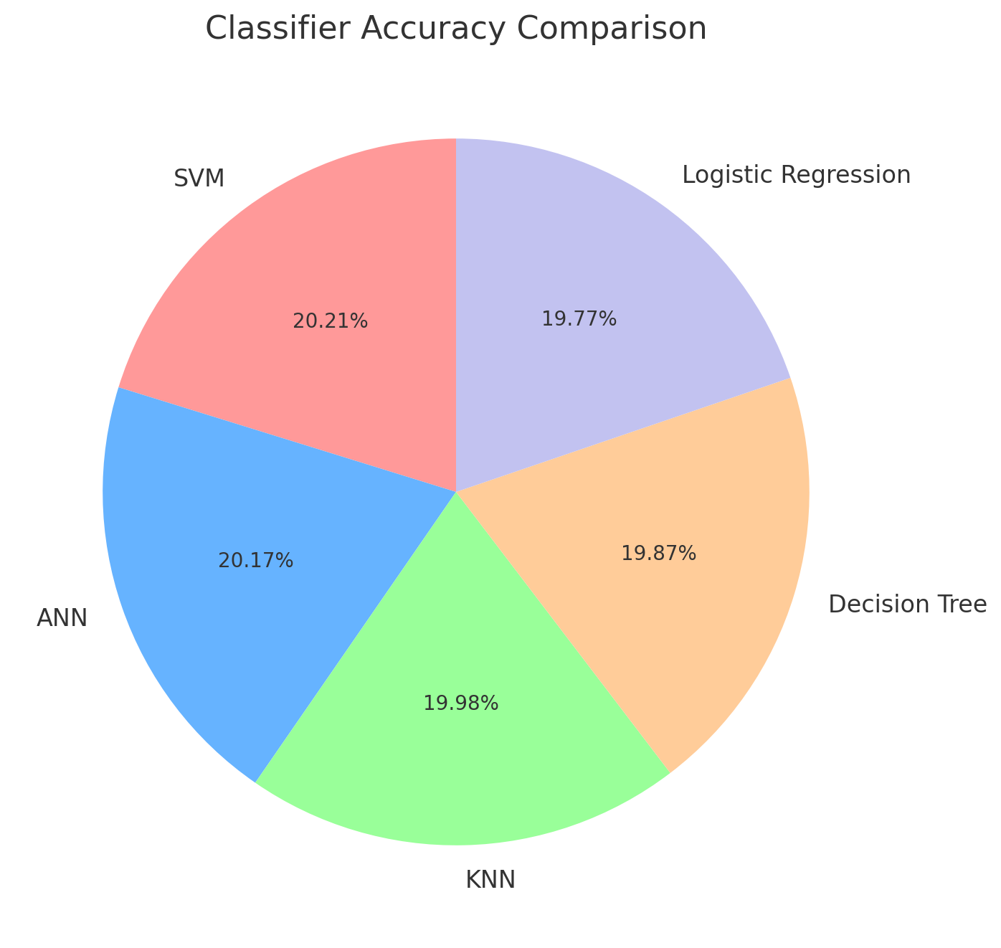
Results and Evaluation
The performance of the models was evaluated using accuracy and user satisfaction as key metrics. The SVM classifier achieved the highest accuracy at 99.94%, followed by the ANN model with 99.71%. The KNN classifier reached 98.80%, the Decision Tree classifier 98.23%, and Logistic Regression 97.72%. These results highlight the effectiveness of the SVM and ANN models in the project.
T

Slide 10



Conclusion and Future Work
In conclusion, the web-based agricultural assistant is an integrated and user-friendly tool that promotes precision agriculture. The system's ability to provide data-driven insights for crop management and soil analysis can significantly enhance farming practices. Future work will focus on developing a mobile application, expanding datasets, integrating IoT devices, and adding multilingual support.
2
Expanded Datasets
1
Mobile App
IoT Integration
3

Slide 11
Q&A?
Thank you for your attention. This concludes the presentation. We are now happy to address any questions you may have regarding the web-based agricultural assistant, its functionalities, the technologies used, or potential future developments. Your inquiries will help us further refine and improve the system to better serve the agricultural community. We appreciate your engagement and look forward to a fruitful discussion.

